Slide 1

WIRELESS CONNECTIVITY ISSUES
Project Guide
DR. M Sesha Shayee
Asst. Prof
By,
GDVS SANDEEP
121812501026
3/3 BCA

Slide 2


Slide 3




CONTENTS
Introduction
Objectives,Abstract , Modules.
Block diagram
Literature survey

Slide 4
INTRODUCTION:
An Intrusion Prevention System (IPS) is a network security/threat prevention technology that examines network traffic flows to detect and prevent vulnerability exploits.
Vulnerability exploits usually come in the form of malicious inputs to a target application or service that attackers use to interrupt and gain control of an application or machine.

Slide 5
Objectives:
The destinations of the task are
1. To beat the issue a crossbreed mix to improve the QoS(Oracle DatabaseMangement) administration is proposed in the examination paper to improve the looking through technique, a hereditary calculation is proposed
2. To improve the better quality in the transmission of parcels, helpful getting is proposed and this methodology positively demonstrates worthier than the underlying variants of responsive
conventions.

Slide 6
Abstract:
The networks are wireless and self-configuring and doesn’t need a pre-existing infrastructure and have a large unpredictable node movements, security becomes one of the most vital issue to be raised into the account.
The proposed approach is based on the analysis and investigations of bandwidth attacks that mainly focus on DDoS(Distributed Denial of Service) that is truly a ruthless challenge and is difficult to detect, and decreases the performance of the network.

Slide 7
An intrusion detection and prevention system is a very important asset in an information security architecture. The primary purpose of an Intrusion detection system (IDS)/Intrusion Prevention System (IPS) is to detect signatures of known attacks, as well as anomalous packet behavior or data flows that occur on computer networks.
(Distributed Denial of Service) DDOS attacks in IOT:
There are two general types of DDOS attacks;
Those crashes the services
(ii) Those floods the services. DDOS attacks can be launched against any protocol layer

Slide 8
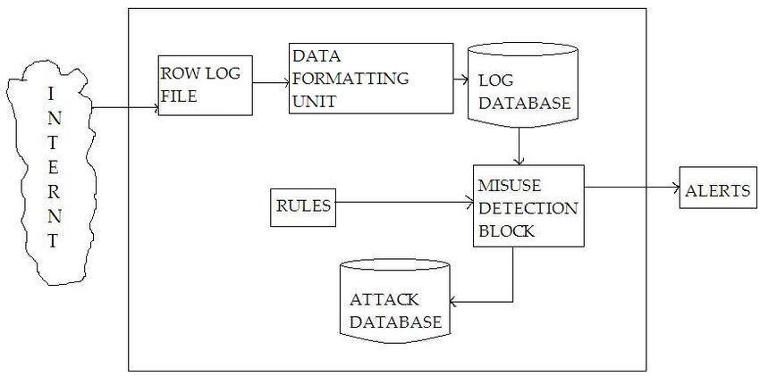
Block diagram

Slide 9
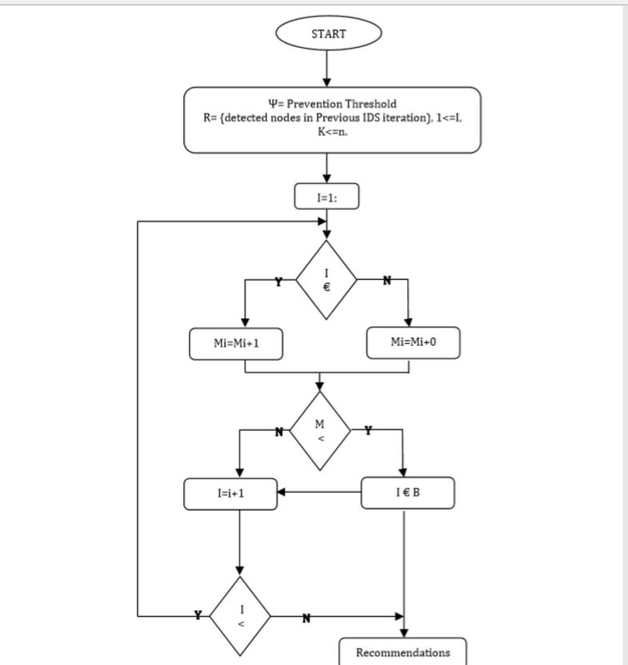
FLOW CHART

Slide 10
Tools used:
OSSEC:
It is Open Source Security, is by far the leading open-source host intrusion detection system. OSSEC is owned by Trend Micro, one of the leading names in IT security. The software, when installed on Unix-like operating systems, primarily focuses on log and configuration files.
Description
OSSEC is a free, open-source host-based intrusion detection system. It performs log analysis, integrity checking, Windows registry monitoring, rootkit detection, time-based alerting, and active response. Wikipedia
Developer: Daniel B. Cid
License: GNU GPL v2
Stable release: 3.6.0 / 14 February 2020; 11 months ago
Programming language: C

Slide 11
OPEN WITSPS(Wireless Intrusion Prevention System–is an open source):
It is on our list mainly because it’s the only one that specifically targets wireless networks. Open WIPS NG–where WIPS stands for Wireless Intrusion Prevention System–is an open source tool which comprises three main components. First, there is the sensor which is a dumb device that only captures wireless traffic and sends it to the server for analysis.
Description
OpenWIPS-ng is an open source and modular Wireless IPS (Intrusion Prevention System). It is composed of three parts:
Sensor(s): "Dumb" devices that capture wireless traffic and sends it to the server for analysis. Also responds to attacks.
Server: Aggregates the data from all sensors, analyzes it and responds to attacks. It also logs and alerts in case of an attack.
Interface: GUI manages the server and displays information about the threats on your wireless network(s).

Slide 12
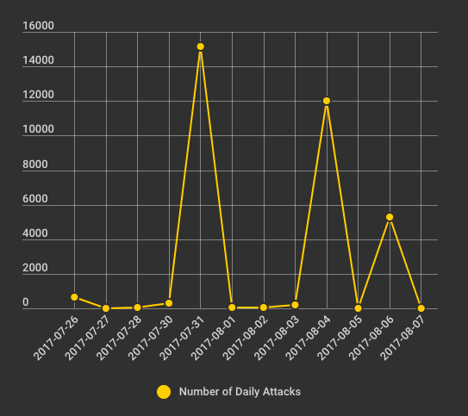
No.of daily attacks

Slide 13
Conclusion:
The Magnitude of DDOS(Distributed Denial-of-Service Attack) and therefore harm as escalated with the inclusion of various different attack sources and therefore creating suitable environment for harming the security and performance of the technology.

Slide 14
REFERENCES
1)T. A. Ahanger and A. Aljumah, "Internet of Things: A Comprehensive Study of Security Issues and Defense Mechanisms," in IEEE Access. doi: 10.1109/ACCESS.2018.2876939 URL: http://ieeexplore.ieee.org/stamp/stamp.jsp?tp=&arnumber=8519613&isnumber=6514899
2) K. Rose, S. Eldridge, and L. Chapin, “THE INTERNET OF THINGS: AN OVERVIEW, Understanding the Issues and Challenges of a More Connected World,” 2015
3) F. Dalipi and S. Y. Yayilgan, “Security and Privacy Considerations for IoT Application on Smart Grids: Survey and Research Challenges,” in 2016 IEEE 4th International Conference on Future Internet of Things and Cloud Workshops (FiCloudW), 2016, pp. 63–68.

Slide 15


